Slide 1
Unit 5 E- Commerce and IT Applications
Lecture 5

Slide 2
Electronic Commerce (E-Commerce)
Electronic commerce, commonly known as E-commerce is trading in products or services using computer networks, such as the Internet.
Electronic commerce draws on technologies such as
Mobile commerce,
Electronic funds transfer,
Supply chain management, Internet marketing,
Online transaction processing,
Electronic data interchange (EDI),
Modern electronic commerce typically uses the World Wide Web (WWW) for at least one part of the transaction's life cycle, although it may also use other technologies such as e-mail.

Slide 3
Definition of E-commerce:
Sharing business information, maintaining business relationships and conducting business transactions using computers connected to telecommunication network is called E-Commerce.

Slide 4
Advantages Of E-commerce:
Buying/selling a variety of goods and services from one's home or business ➢
Anywhere, anytime transaction
Can look for lowest cost for specific goods or service
Businesses can reach out to worldwide clients - can establish business partnerships
Order processing cost reduced
Electronic funds transfer faster
Supply chain management is simpler, faster, and cheaper using ecommerce
eg. Can order from several vendors and monitor supplies.

Slide 5
Disadvantages Of E-commerce:
Electronic data interchange using EDI is expensive for small businesses
Security of internet is not very good - viruses, hacker attacks can paralise e-commerce
Privacy of e-transactions is not guaranteed
E-commerce de-personalises shopping

Slide 6
Business models of e-commerce:
There are mainly 4 types of business models based on transaction party.
Business-to-Consumer (B2C)
In a Business-to-Consumer E-commerce environment, companies sell their online goods to consumers who are the end users of their products or services.
Usually, B2C E-commerce web shops have an open access for any visitor, meaning that there is no need for a person to login in order to make any product related inquiry
The B2C model also includes services online banking, travel services, and health information and many more.

Slide 7
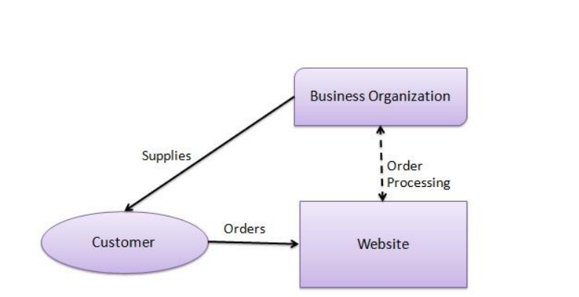
Examples of virtual merchants include amazon.com (books. electronics, toys, and music), eToys.com (children's books and toys).
Figure: B2C

Slide 8
2. Business-to-Business (B2B)
In a Business-to-Business E-commerce environment, companies sell their online goods to other companies without being engaged in sales to consumers.
In most B2B E-commerce environments entering the web shop will require a log in.
B2B web shop usually contains customer-specific pricing, customer-specific assortments and customer-specific discounts.
Sometimes in the B2B model, business may exist between virtual companies, neither of which may have any physical existence.
In such cases, business is conducted only through the Internet.
Let us look at the example of www.amazon.com.

Slide 9
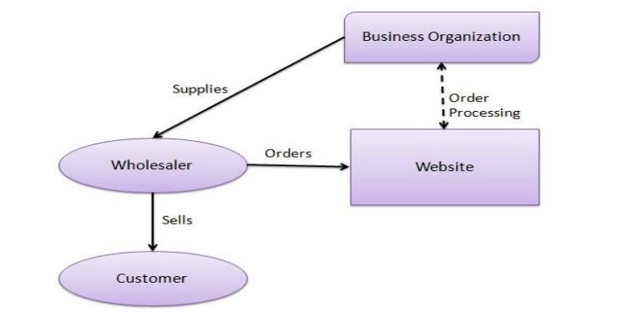
Figure: B2B

Slide 10
3. Consumer-to-Business (C2B)
In a Consumer-to-Business E-commerce environment, consumers usually post their products or services online on which companies can post their bids.
A consumer reviews the bids and selects the company that meets his price expectations.
It is similar to the B2C model, however, the difference is that in this case the consumer is the seller and the business organization is the buyer.
In this kind of a transaction, the consumers decide the price of a particular product rather than the supplier.
For example, www.monster.com is a Web site on which a consumer can post his bio-data for the services he can offer.

Slide 11
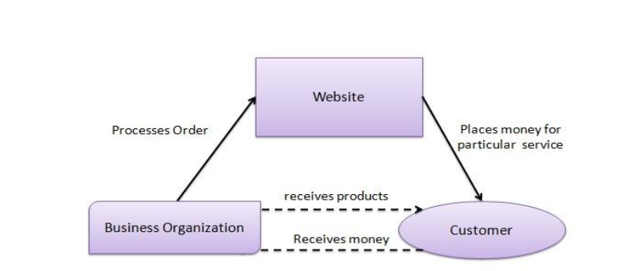
Figure: C2B

Slide 12
4. Consumer-to-Consumer (C2C)
In a Consumer-to-Consumer E-commerce environment consumers sell their online goods to other consumers.
A well-known example is eBay
The C2C model involves transaction between consumers.
Here, a consumer sells directly to another consumer.
eBay and www.bazee.com are common examples of online auction Web sites that provide a consumer to advertise and sell their products online to another consumer

Slide 13
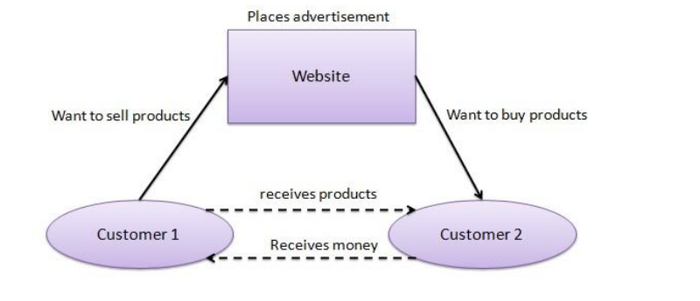
Figure C2C

